Slide 1
Her-2 evaluation in non breast and gastric Carcinomas
Cristovam Scapulatempo Neto
Diretor médico de patologia e genômica DASA

Slide 2
Disclosure of Relevant Financial Relationships
Essa é uma aula patrocinada pela Astra Zeneca e estous recebendo para o preparo da aula e para ministrar esse treinamento
RDC Nº 96/08 da ANVISA

Slide 3
HER-2 IN ENDOMETRIAL CARCINOMAS

Slide 4
HER-2 IN ENDOMETRIAL CARCINOMAS
Current “endometrial cancer” criteria in USA: endorsed by CAP
HER2 IHC 3+ (positive) | Strong complete or basolateral/lateral membrane staining in > 30% of tumor cells
HER2 IHC 2+ (equivocal) | Strong complete or lateral/basolateral membrane staining was seen in ≤ 30%, or weak to moderate staining in ≥10% of tumor cells
HER2 IHC 1+ (negative) | Faint/barely perceptible, incomplete membrane staining in any proportion of tumor, or weak complete staining in
HER2 IHC 0 (negative) | No staining in tumor cells
-
Int J Gynecol Pathol. 2020;40(1):17-23.

Slide 5
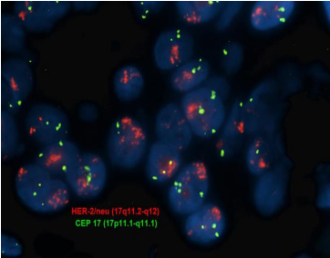
HER-2 IN ENDOMETRIAL CARCINOMAS
ISH is indicated for, at minimum, any IHC 2+ cases: “endometrial cancer” FISH criteria
-
HER2 gene amplification is present (positive/amplified) | HER2/CEP17 signal ratio of ≥2.0, or <2.0 with ≥6 HER2 signals on average/ nucleus
HER2 gene amplification is absent (negative/nonamplified) | FISH HER2/CEP17 Ratio < 2.0 and average HER2 copy number < 6 /nucleus
Int J Gynecol Pathol. 2020;40(1):17-23.

Slide 6
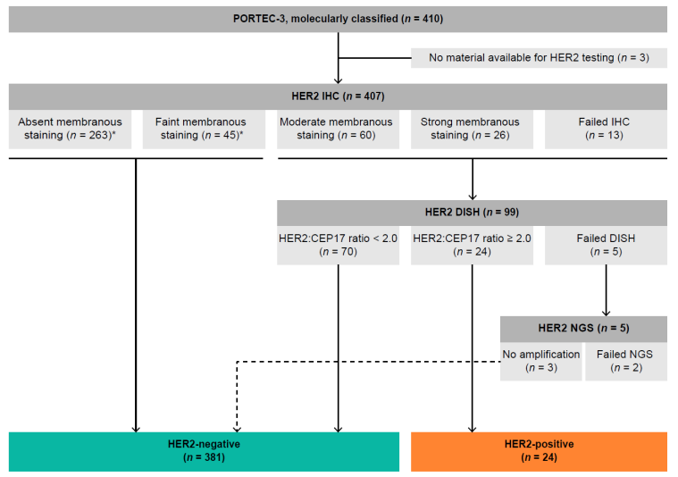
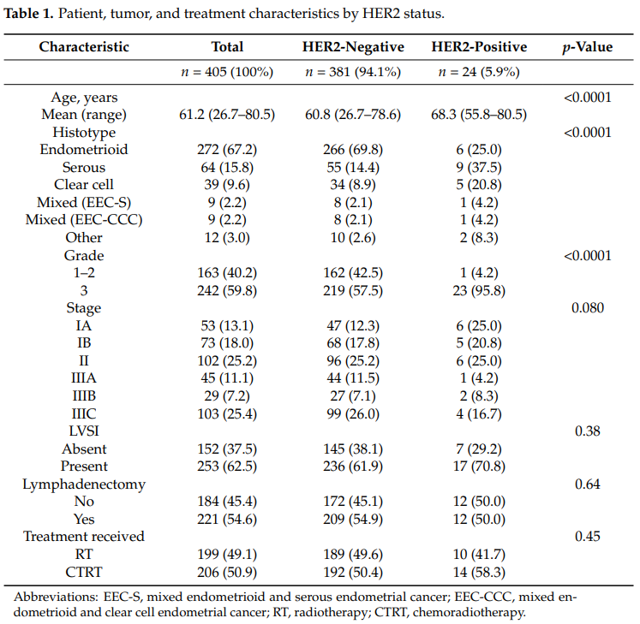
HER-2 IN ENDOMETRIAL CARCINOMAS
HER2 Status in High-Risk Endometrial Cancers (PORTEC-3): Relationship with Histotype, Molecular Classification, and Clinical Outcomes
-
Cancers 2021, 13(1), 44

Slide 7
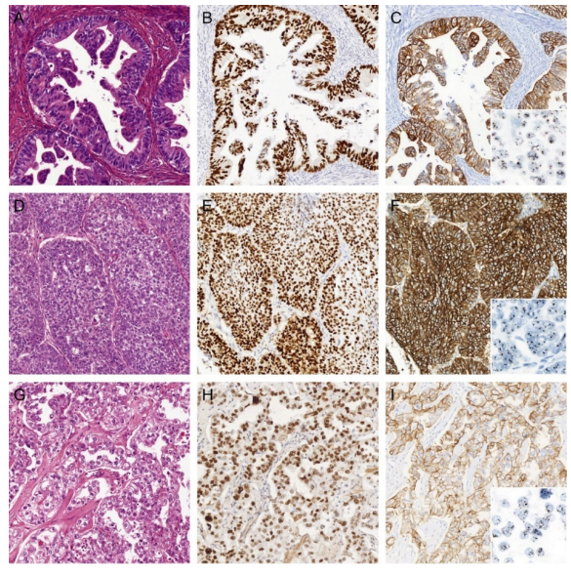
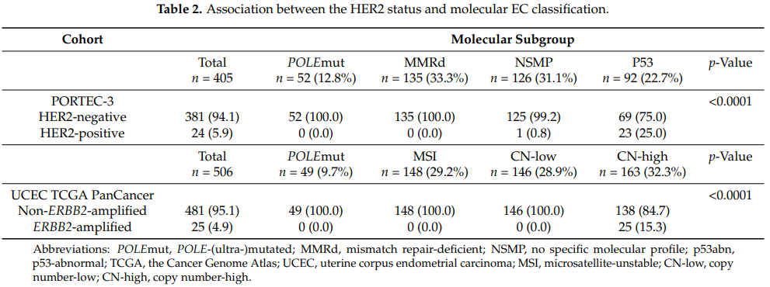
HER-2 IN ENDOMETRIAL CARCINOMAS
HER2 Status in High-Risk Endometrial Cancers (PORTEC-3): Relationship with Histotype, Molecular Classification, and Clinical Outcomes
-
Her-2 positive EC are mostly p53 abn molecular subtype
Cancers 2021, 13(1), 44
Notes:
Figure 2. Three examples of HER2-positive endometrial cancers (EC) of non-serous histology. (A) H&E of an EC diagnosed as International Federation of Gynecology and Obstetrics (FIGO) grade 2 endometrioid EC (EEC) with (B) aberrant mutant-like p53 immunostaining, (C) strong (in)complete membranous HER2 immunostaining, and HER2 gene amplification by dual in situ hybridization (DISH). (D) H&E of an EC diagnosed as FIGO grade 3 EEC with (E) aberrant mutant-like p53 immunostaining, (F) strong complete membranous HER2 immunostaining, and HER2 gene amplification by DISH. (G) H&E of an EC diagnosed as endometrial clear cell carcinoma with (H) aberrant mutant-like p53 immunostaining, (I) strong complete membranous HER2 immunostaining, and HER2 gene amplification by DISH. All images ×20 objective magnification.

Slide 8
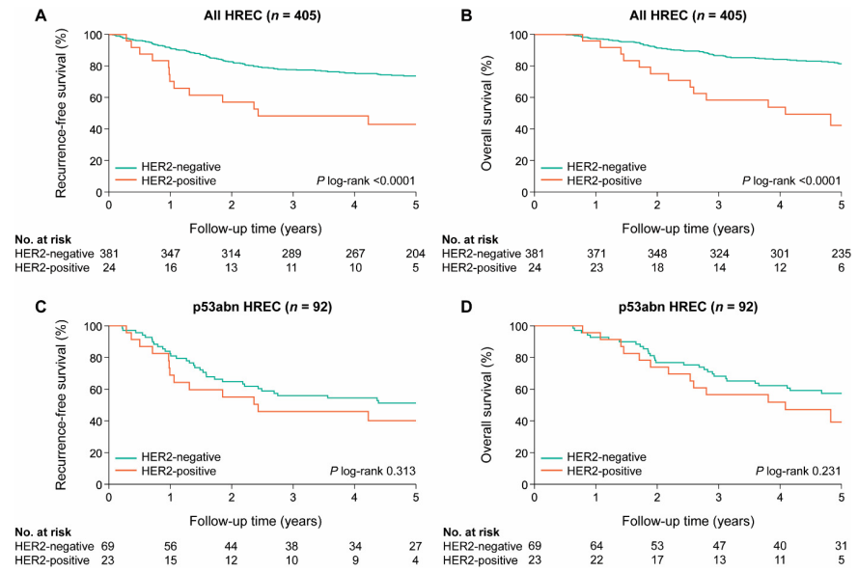
HER-2 IN ENDOMETRIAL CARCINOMAS
HER2 Status in High-Risk Endometrial Cancers (PORTEC-3): Relationship with Histotype, Molecular Classification, and Clinical Outcomes
-
- HER2 status did not have independent prognostic value for survival after correction for the molecular classification
Cancers 2021, 13(1), 44

Slide 9
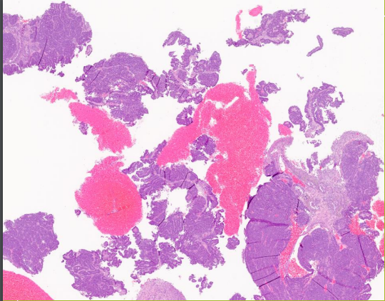
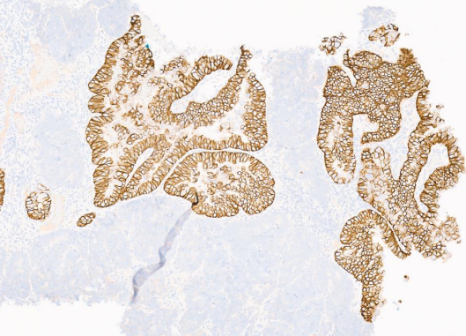
HER-2 IN ENDOMETRIAL CARCINOMAS
Intratumoral staining heterogeneity (ITH)
-
• Defined as “the presence of at least two-degree difference in staining intensity (none to moderate, weak to strong or none to strong) involving at least 5% of tumor cells”
• ITH was found to be present in 31% of serous carcinomas, including 53% of HER2-positive cases and 19% of HER2-negative cases
Mod Pathol. 2013 Dec;26(12):1605-12, Int J Gynecol Pathol. 2024 Jan 1;43(1):4-14

Slide 10
HER-2 IN ENDOMETRIAL CARCINOMAS
-
• Overall Biopsy/Hysterectomy Concordance Rate for HER2 status: 84% of cases (31/37).
• Identical HER2 immunohistochemical scores in 65% of tumors.
• Among the 6 tumors with a discordant HER2 status, 2 were HER2 negative in the biopsy and positive in the hysterectomy, and 4 were HER2-positive in the biopsy and negative in the hysterectomy.
• The false-negative rate would be 15.4% if only biopsy tested.
• The false negative rate would be 26.7% if only the hysterectomy were tested.
• All cases with discordant results also showed intratumoral heterogeneity
Mod Pathol. 2013 Dec;26(12):1605-12, Int J Gynecol Pathol. 2024 Jan 1;43(1):4-14

Slide 11
HER-2 IN ENDOMETRIAL CARCINOMAS
-
• 14 paired samples, pre and post treatment with anti-HER2 therapy.
• Decreased HER2 protein expression (i.e. decreased IHC score) in post-treatment relative to pre-treatment ECs from 7/14 (50%) patients
• 4 cases: Pre-treatment IHC3+ to Post-treatment IHC0/1+, despite post treatment HER2 amplification or HER2 neutral status
• 3 cases: Pre-treatment IHC3+ to Post-treatment IHC2+ Thought to occur through transcript downregulation or selection of HER2-non-amplified tumor cells
Mod Pathol. 2013 Dec;26(12):1605-12, Int J Gynecol Pathol. 2024 Jan 1;43(1):4-14

Slide 12
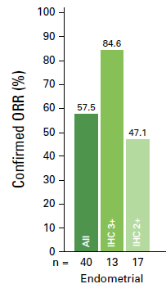
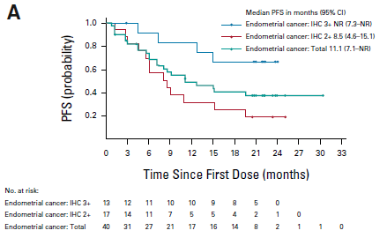
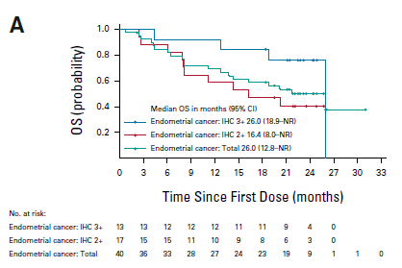
HER-2 IN ENDOMETRIAL CARCINOMAS
-
Median PFS: 11 months
PFS 6m: 74 %
PFS 12 m: 49,2 %
Median OS: 26 months
PFS 6m: 84,7 %
PFS 12 m: 69,3 %
Meric-Bernstam F, et al. J Clin Oncol. 2024 Jan 1;42(1):47-58

Slide 13
HER-2 IN ENDOMETRIAL CARCINOMAS
SUMMARY
HER2 status has prognostic and predictive value.
HER2 amplification/overexpression is not specific to any one histotype, and is mostly seen in the p53 abn molecular subgroup.
HER2 status may be tested by IHC, ISH, NGS or IHC/ISH combinations.
There are HER2 IHC and FISH criteria that are endorsed by CAP.
Slightly over half -50-60%- of cancers are IHC score 2+ by “endometrial cancer” criteria; these have a 26-67% FISH positive rate
Approx. one-third of serous carcinomas or carcinosarcomas show intratumoral staining and/or genetic heterogeneity.
Consider HER2 testing in biopsies of selected cancers depending on local concerns (p53 abn molecular subclass [ideal], or if molecular testing is unavailable, p53-aberrant cancers, histotype directed etc); if HER2-negative in biopsy, repeat the test in the resection if advanced stage.
Consider performing both HER2 IHC and ISH on all post-anti-HER2 chemotherapy recurrences.
Endometrial carcinomas with Her-2 3+ expression have the best clinical benefits with anti Her-2 therapy (T-Dx)
-

Slide 14
HER-2 IN COLORECTAL CARCINOMAS
-
Mod Pathol 28, 1481–1491 (2015).

Slide 15
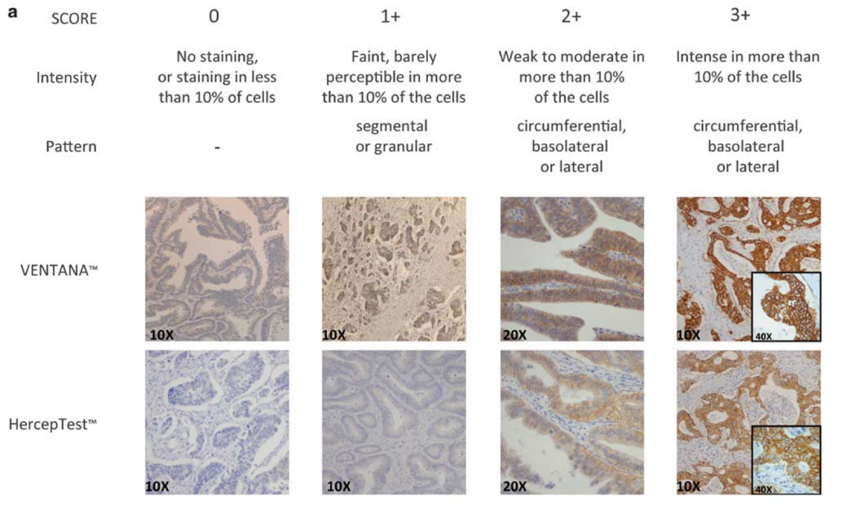
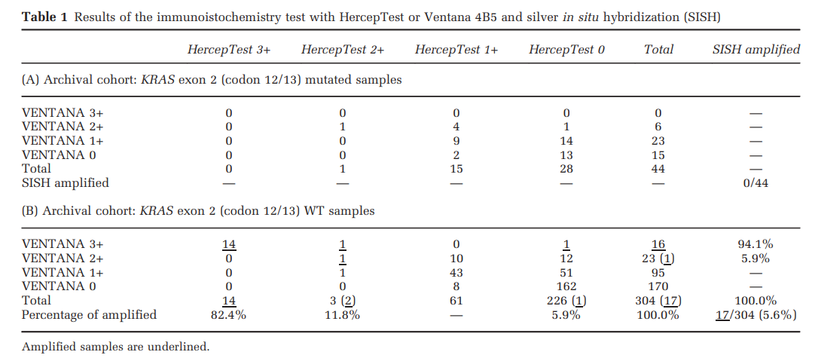
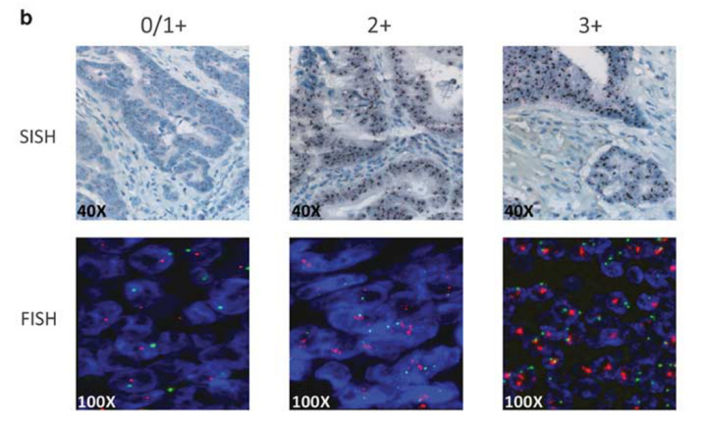
HER-2 IN COLORECTAL CARCINOMAS
Traztuzumab+lapatinib
Heracles trial
ARCHIVAL COHORT
-
None KRAS exon2 mutated tumor were Her-2 amplified
Her-2 amplification:
. Herceptest: 3+: 82,4% 2+: 11,8% 0+:5,9%
. 4B5: 3+: 94,1% 2+: 5,9% 0+ : 0%
Mod Pathol 28, 1481–1491 (2015).

Slide 16
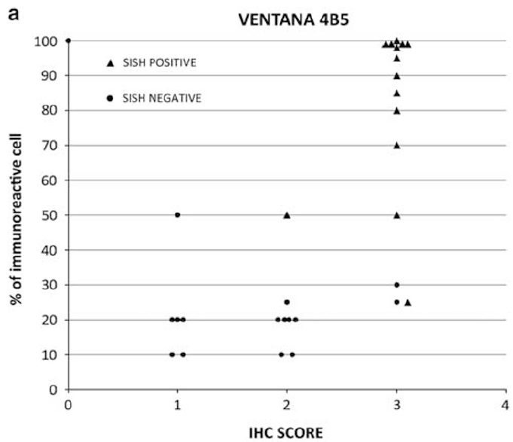
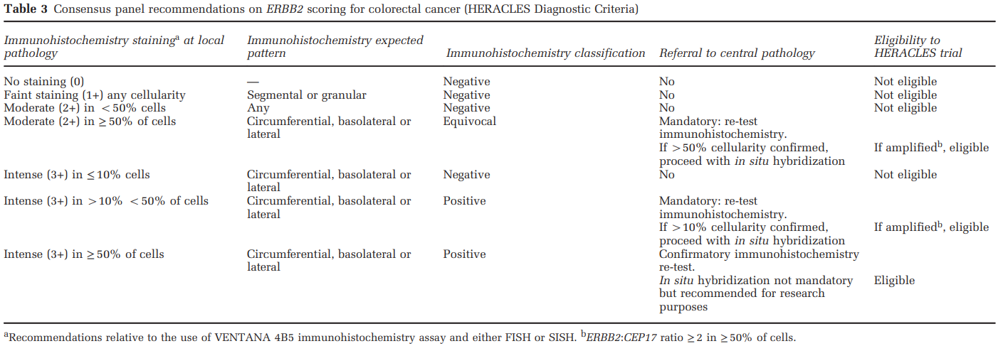
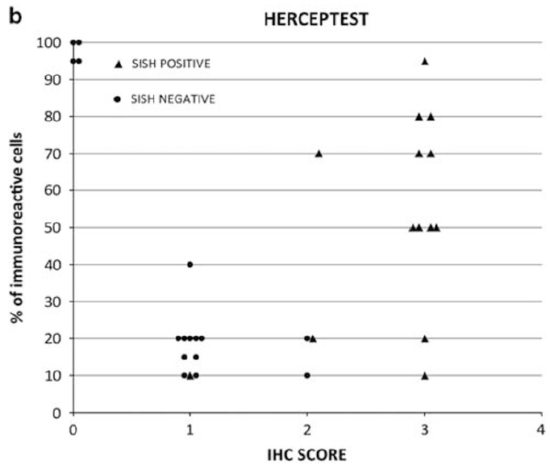
HER-2 IN COLORECTAL CARCINOMAS
HERACLES DIAGNOSTIC CRITERIA
-
Mod Pathol 28, 1481–1491 (2015).

Slide 17
HER-2 IN COLORECTAL CARCINOMAS
HERACLES DIAGNOSTIC CRITERIA
-
In conclusion, in a series of 1086 colorectal cancers, we optimized a diagnostic decisional algorithm referred to as HERACLES Diagnostic Criteria for ERBB2 protein overexpression and documented that ERBB2 amplification occurs in 5% of the population.
Mod Pathol 28, 1481–1491 (2015).

Slide 18
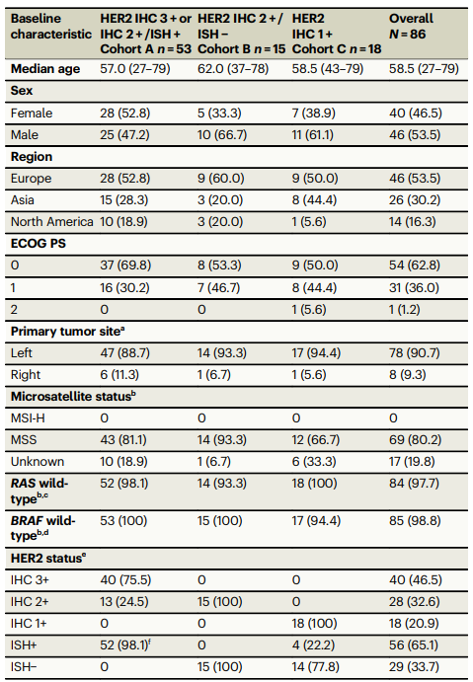
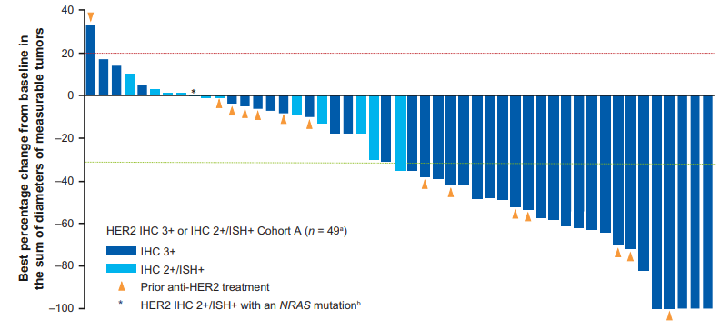
Phase 2 trial assessing the efficacy and safety of trastuzumab deruxtecan (T-DXd) in patients with HER2-expressing metastatic colorectal cancer (mCRC)
that progressed after ≥2 prior regimens;
Nat Commun 14, 3332 (2023).

Slide 19
HER-2 IN COLORECTAL CARCINOMAS
HER-2 +: IHC 3+, IHC 2+ ISH+, NGS amplified
RAS wild-type and RAS mutant subpopulations
HER2 + is higher in KRAS wt tumores (6,5% vs 1,1%).
Metastatic and nonmetastatic populations:
No statistical difference between metastatic and non metastatic CRC
Sidedness:
HER2+ were statistically higher in left-sided CRC patients compared with right-sided CRC patients (5.8 vs 2.7%).
Microsatellite stability and microsatellite instability:
- HER2+ was enriched in microsatellite stability CRC (98.8%-100%) and scarce in microsatellite instable-high CRC (0%- 1.2%)
Cancers 2021, 13(1), 44

Slide 20
HER-2 IN COLORECTAL CARCINOMAS
SUMMARY
HER-2 + CRC: 4,2-6,5% OF ALL CRC
ANTI HER-2 THERAPY FOR mCRC IS A REALITY BUT FOR SELECTED CASES:
. KRAS, NRAS AND BRAFV600E WILD TYPE TUMORS
. MICROSATELITE STABLE TUMORS
RESPONSE TO ANTI HER-2 THERAPIES ARE OBSERVED ONLY IN HER2+ (HER2 IHC 3+ and IHC 2+/ISH+).
THERE IS NO RESPONSE IN HER-2 LOW CRC PATIENTS.
Her-2 positive CRC have clinical benefits with anti Her-2 therapy (T-Dx)
Cancers 2021, 13(1), 44

Slide 21
HER-2 IN OVARIAN CARCINOMAS

Slide 22
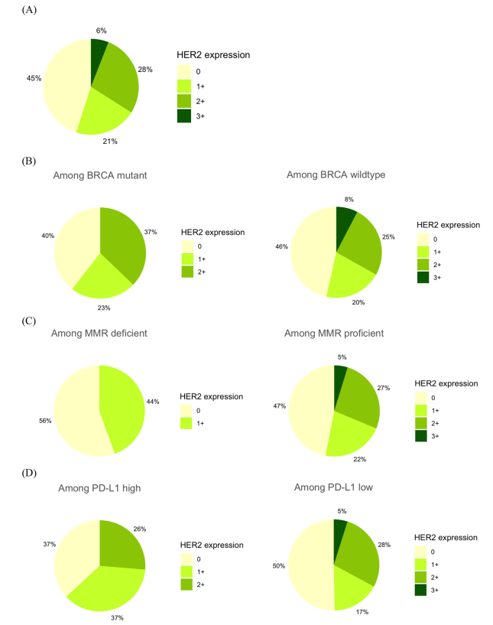
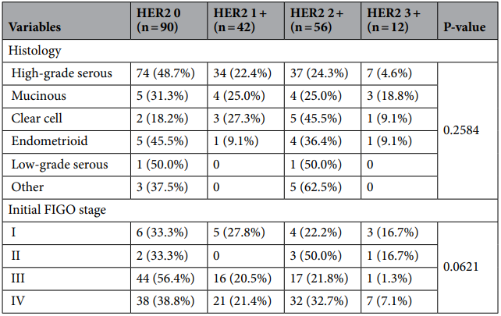
HER-2 IN OVARIAN CARCINOMAS
200 Patients
Her-2 clone SP3 accordind to TOGa trial
Her2 3+:
. 6% of all ovarian carcinomas.
. Only in BRCA wt tumors (8%)
. MMR proficient tumors (5%)
. PDL-1 low (CPS <10): 5%
There is no difference in Her-2 expression between different ovarian tumor subtypes and Stage
Sci Rep 14, 7992 (2024).

Slide 23
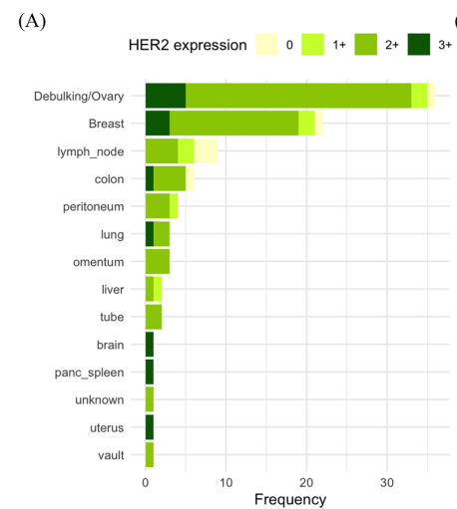
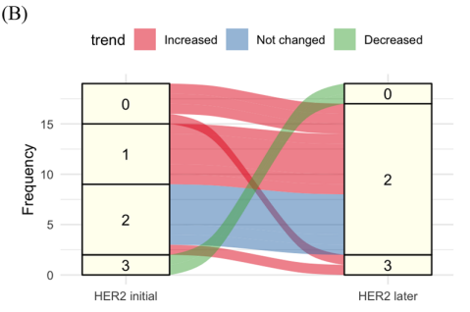
HER-2 IN OVARIAN CARCINOMAS
Among 19 patients who underwent multiple timelagged
biopsies, 11 (57,9%) showed increased HER2 expression in subsequent biopsies and remained unchanged in 6 (31.6%)
The anatomical distribution of tumors among patients with HER2 2+ and 3+ scores
Sci Rep 14, 7992 (2024).

Slide 24
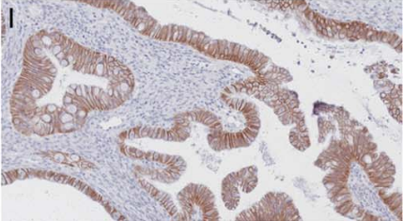
HER-2 IN OVARIAN CARCINOMAS
Uncommon type of Ovarian Carcinoma (3-4%).
Recurrent genomic alterations in KRAS, MYC, ERBB2, and TP53.
Advanced MOCs: Resistance to platinum-based chemotherapy, poor prognosis.
Her-2 (SP3)
ASCO/CAP Breast and TOGa.
Heterogeneity: 3+ >5% <50%
29 tumors of 23 patients.
N=23 | 2+ | 3+ | final
Breast | 8 (35%) | 6 (26%) | 6
GI | 13 (57% | 7 (30%) | 7
ASCO/CAP guidelines are accurate and resource-effective in determining HER2 overexpression in mucinous ovarian carcinoma.
Int J Gynecol Pathol Vol. 43, No. 3, May 2024

Slide 25
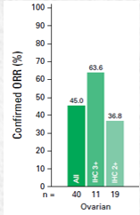
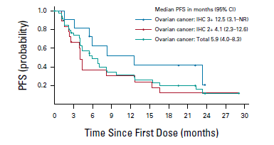
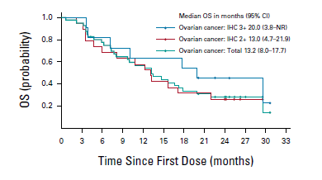
HER-2 IN OVARIAN CARCINOMAS
Median PFS: 5,9 months
PFS 6m: 48,9 %
PFS 12 m: 31,6 %
Median OS: 13,2 months
PFS 6m: 77,3 %
PFS 12 m: 56,7 %
Meric-Bernstam F, et al. J Clin Oncol. 2024 Jan 1;42(1):47-58

Slide 26
HER-2 IN OVARIAN CARCINOMAS
SUMMARY
There are not stitiscial difference of her-2 expression in ovary cancer according to histological subtypes.
Mucinous carcinoma are more frequent Her-2 positive (25-30%).
HER-2 evaluation of ovary cancers should be done according TOGa Trial criteria.
Ovarian carcinomas with Her-2 3+ expression have the best clinical benefits with anti Her-2 therapy (T-Dx).

Slide 27
HER-2 IN CERVICAL CARCINOMAS

Slide 28
HER-2 IN CERVICAL CARCINOMA
1- How common is HER2 overexpression/amplification in patients with invasive CC?
2- Is the proportion of HER2-positive CC significantly different in studies that used ASCO/ CAP compliant methodology and those that used other methods?
3- Is there a relationship between HER2 pooled prevalence and relevant subgroups, such as histologic subtype, World Health Organization (WHO) geographic region, tumor stage, primary antibody brand, and year of publication?
PLoS ONE 16(9): e0257976

Slide 29
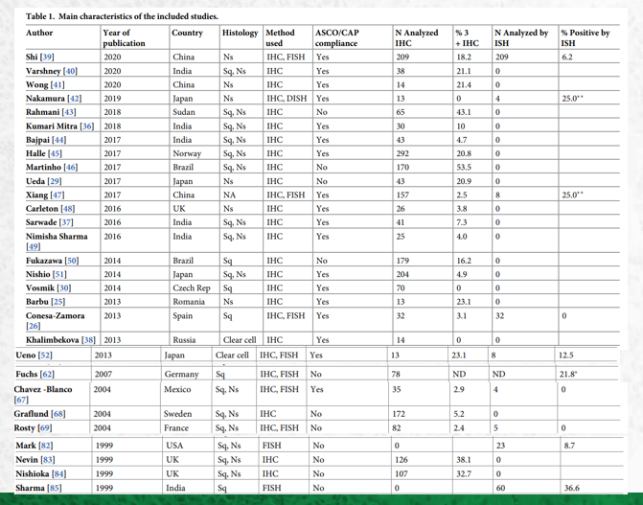
HER-2 IN CERVICAL CARCINOMA
IHC 3+: 2,5% - 32,7%
Her-2 amplification: 6,0% - 36%
Different methodologies for Her-2 analysis
PLoS ONE 16(9): e0257976

Slide 30
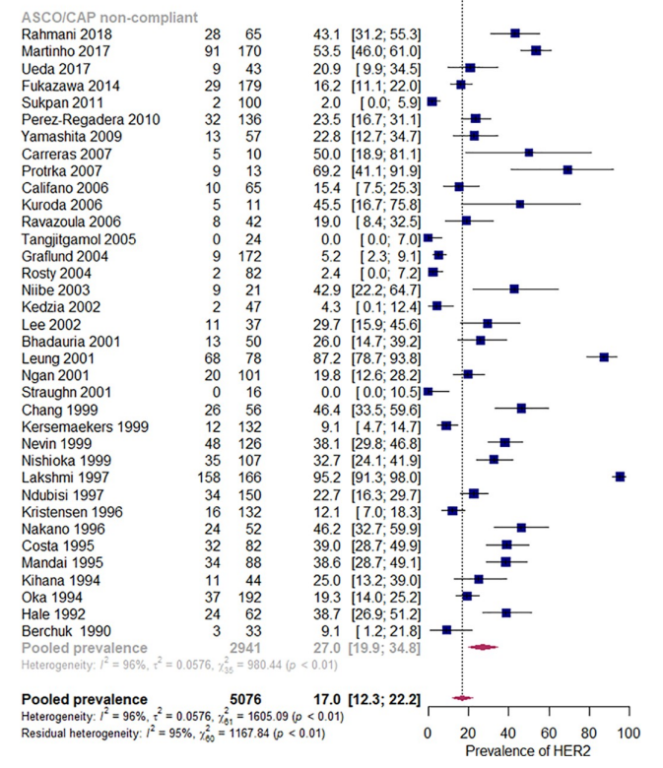
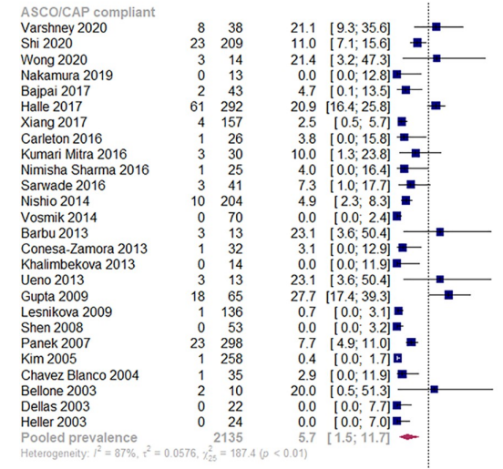
HER-2 IN CERVICAL CARCINOMA
HER-2 OVEREXPRESSION : 17,0%
CAP/ASCO COMPLIANT= 5,7%
CAP/ASCO NON COMPLIANT= 27,0%
PLoS ONE 16(9): e0257976

Slide 31
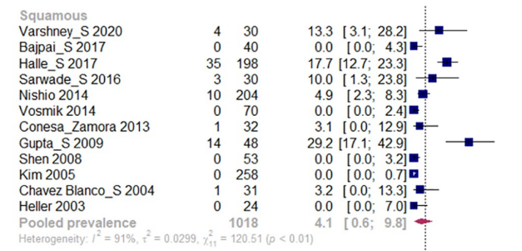
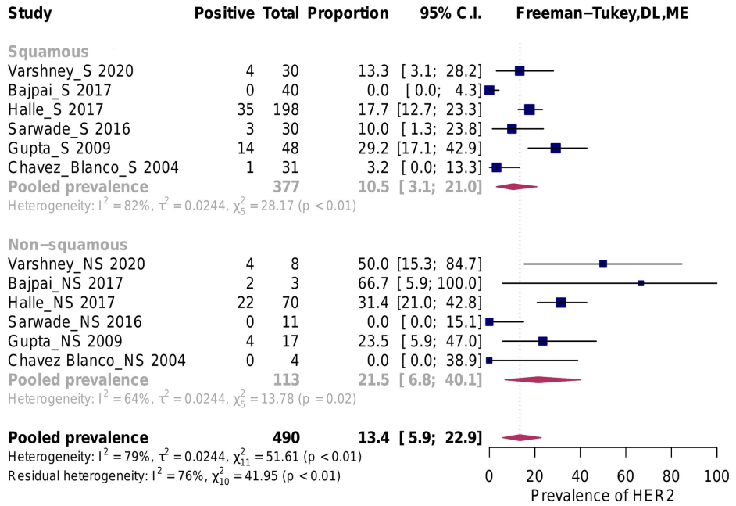
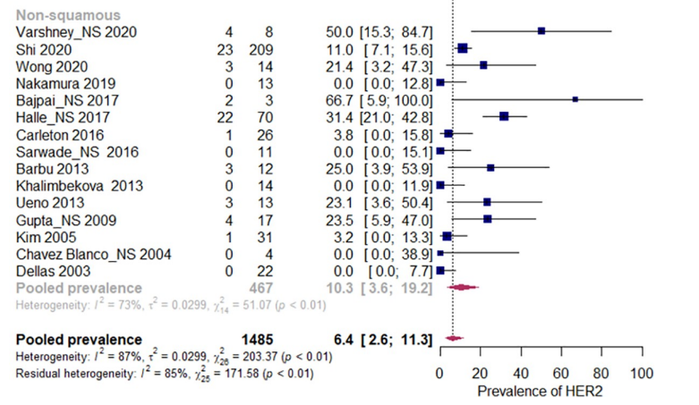
HER-2 IN CERVICAL CARCINOMA
Maior frequência de positividade para Her-2 em Adenocarcinomas
Studies that included both squamous and non-squamous histology
HER2 overexpression was 4.1%
HER2 overexpression in non-squamous carcinoma was 10.3%
PLoS ONE 16(9): e0257976

Slide 32
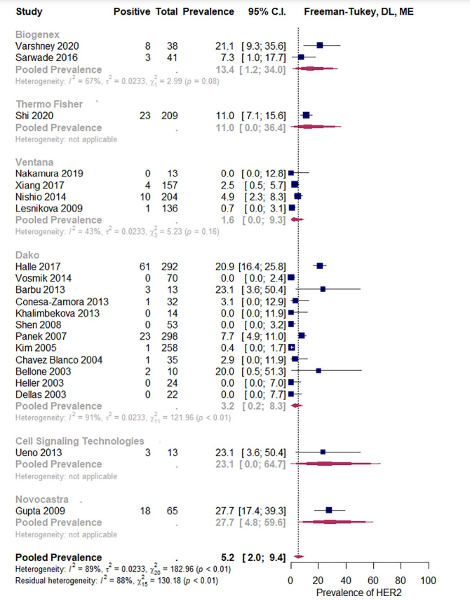
HER-2 IN CERVICAL CARCINOMA
Overexpression frequency according
to antibody brand
DAKO HERCEPTEST SHOWED TWICE OF THE POSITIVITY OF VENTANA
PLoS ONE 16(9): e0257976

Slide 33
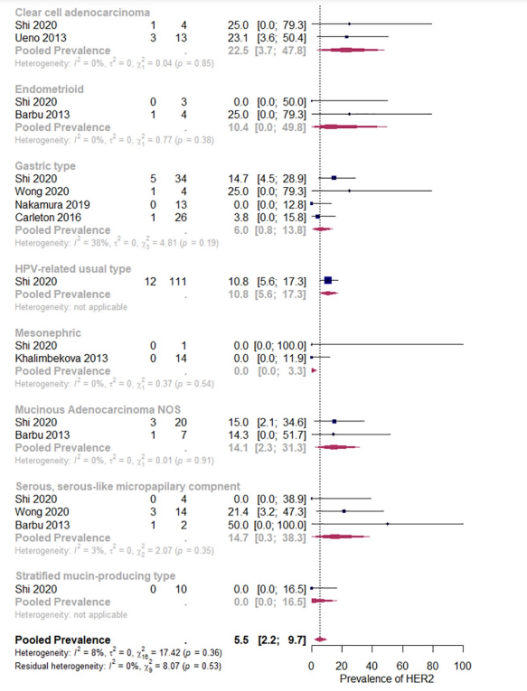
HER-2 IN CERVICAL CARCINOMA
Her-2 amplification according to histological subtypes
HPV related usual type: 10,8%
Clear cell carcinoma: 22,5%
Endometrioid: 10,4%
Serous carcinoma: 14,7%
Mucinous Adenocarcinoma: 14,1%
Gastric : 6,0%
Mesonephric: 0%
PLoS ONE 16(9): e0257976

Slide 34
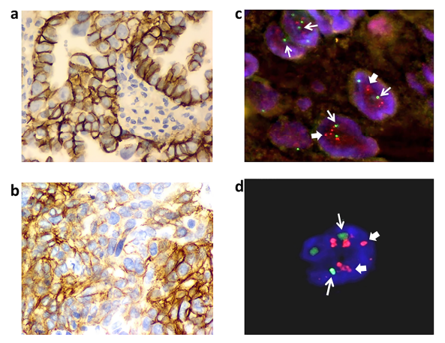
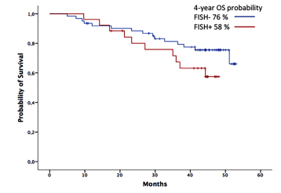
HER-2 IN CERVICAL CARCINOMA
Poor correlation between HER-2 IHC and FISH.
Gene amplification is frequent, occurring in 29.5% of cases
. 30,6% of SCC
. 25% of Adenocarcinomas
- Her-2 amplification is not associated with lower OS
p =0.23.
Eur. J. Gynaecol. Oncol. - ISSN: 0392-2936 XLI, n. 6, 2020 .

Slide 35
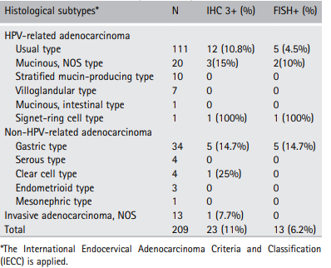
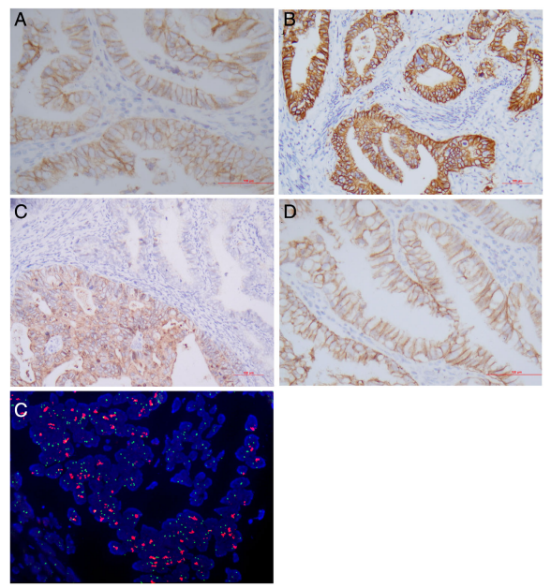
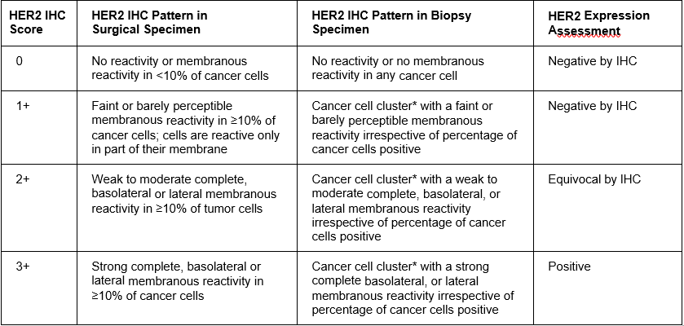
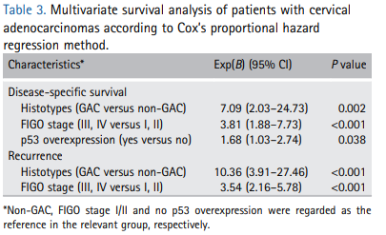
HER-2 IN CERVICAL CARCINOMA
209 Cervical adenocarcinomas
Ventana 4B5 antibody
Her-2 evaluation according to ASCO/CAP gastric and GEJ algorithm
J Pathol Clin Res January 2021; 7: 86–95
Notes:
Few studies have explored HER2 status in cervical adenocarcinoma, particularly in the gastric-type adenocarcinoma
(GAC), a nonhuman-papillomavirus-related subtype with poor clinical outcomes. In this study, we investigated
HER2 expression and amplification by immunohistochemistry (IHC) and fluorescence in situ hybridization
(FISH) in 209 well annotated cervical adenocarcinomas diagnosed using the International Endocervical Adenocarcinoma
Criteria and Classification. IHC identified HER2 protein expression in 57.4% (123/209) of adenocarcinomas,
of which 62 were IHC 1+ (negative), 38 2+ (equivocal) and 23 3+ (positive). HER2 amplification was
found in 13 cases (6.2%) including 10 with IHC 3+ and 3 with IHC 2+. Among all the major histotypes of cervical
adenocarcinoma, HER2 amplification was most common in GAC cases with a frequency of 14.7% (5/34).
Moreover, HER2 amplification was more frequently associated with 2018 International Federation of Gynecology
& Obstetrics (FIGO) stage III/IV, perineural involvement and ovarian spread (p < 0.05) while IHC 3+ was more
common in patients with lymphovascular invasion and ovarian involvement (p < 0.05). Survival analysis indicated
that FIGO stage III/IV, GAC, and p53 overexpression were associated with poor disease-specific survival and tumor
recurrence (p < 0.05). In conclusion, HER2 amplification was present in a subset of adenocarcinomas, and more
common in GAC, pointing to a potential benefit from trastuzumab treatment. HER2 overexpression does not
identify gene amplification status in cervical adenocarcinoma; therefore, FISH is suggested for both IHC positive
and equivocal cases. Further investigation on more cases with longer follow-up times is required to consolidate
these findings.

Slide 36
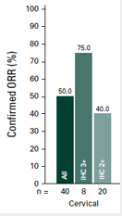
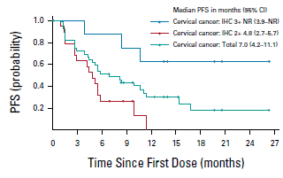
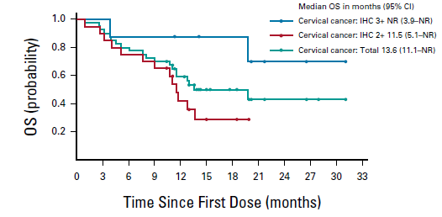
HER-2 IN CERVICAL CARCINOMAS
-
Median PFS: 7 months
PFS 6m: 51,3 %
PFS 12 m: 29,9 %
Median OS: 11,1 months
PFS 6m: 80,0 %
PFS 12 m: 59,1 %
Meric-Bernstam F, et al. J Clin Oncol. 2024 Jan 1;42(1):47-58

Slide 37
HER-2 IN CERVICAL CARCINOMA
Summary
There is not a good correlation between Her-2 expression and Her-2 amplification in cervical carcinomas.
Adenocarcinomas are more prone to be Her-2 positive.
Gastric type and mucinous (NOS) cervical adenocarcinoma has the highest prevalence of Her-2 amplification.
Cervical carcinomas with Her-2 3+ expression have the best clinical benefits with anti Her-2 therapy (T-Dx) .
Clin. Oncol., 2013, 31, 3997-4013.

Slide 38
HER-2 IN LUNG CARCINOMAS

Slide 39
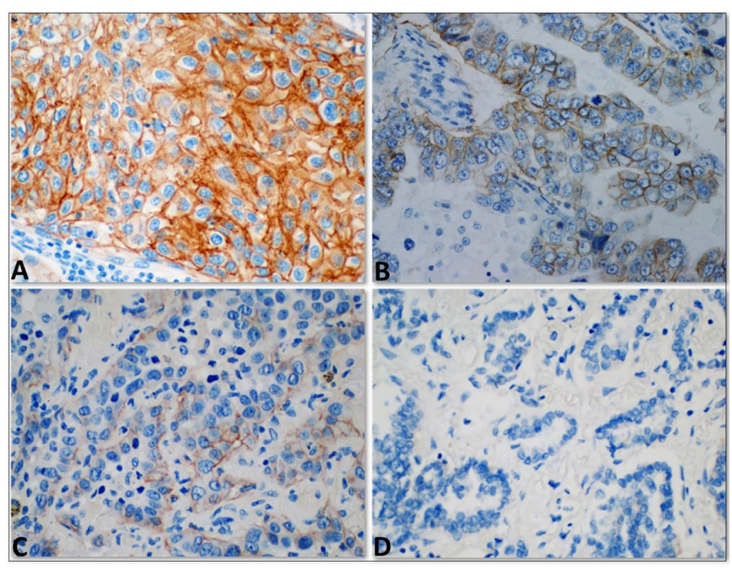
HER-2 IN LUNG CARCINOMAS
Her-2 overexpression (3+): 13-20% of NSCLC.
Her-2 amplification: 2-22,8%
. 13% of acquired resistance in EGFR mutant NSCLC
Her-2 insertion (exon 20) 2-4,5% of NSCLC; also mechanism of resistance to anti EGFR therapy.
No obvious correlation between overexpression and amplification.
WORSE OVERALL SURVIVAL
All studies used CAP/ASCO HER-2 breast guidelines for Her-2 expression evaluation
J Thorac Dis 2021;13(6):3708-3720
Diagn Pathol. 2023 Jun 20;18(1):75.

Slide 40
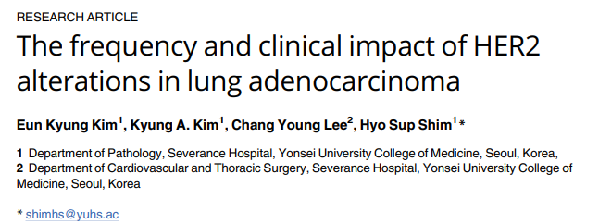
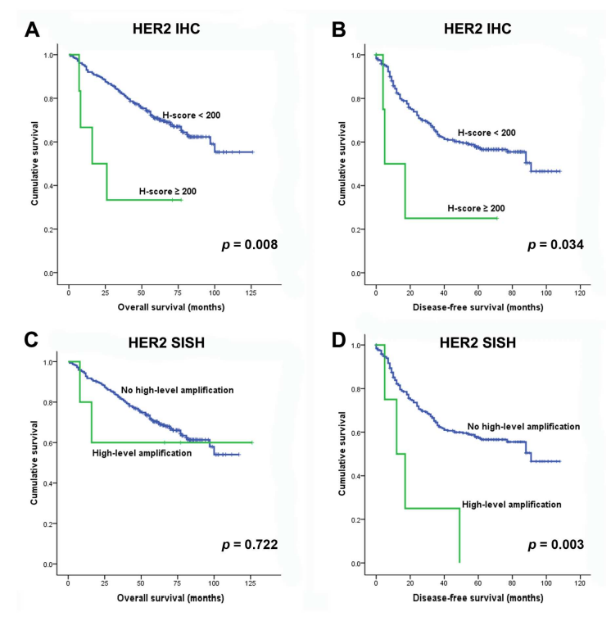
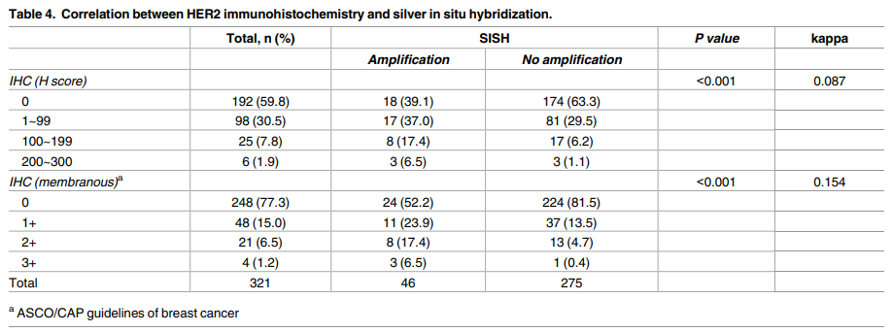
HER-2 IN LUNG CARCINOMAS
321 casos
Ventana 4B5
TMA
Ausência de associação entre IHC and ISH
PLoS ONE 12(2): e0171280.

Slide 41
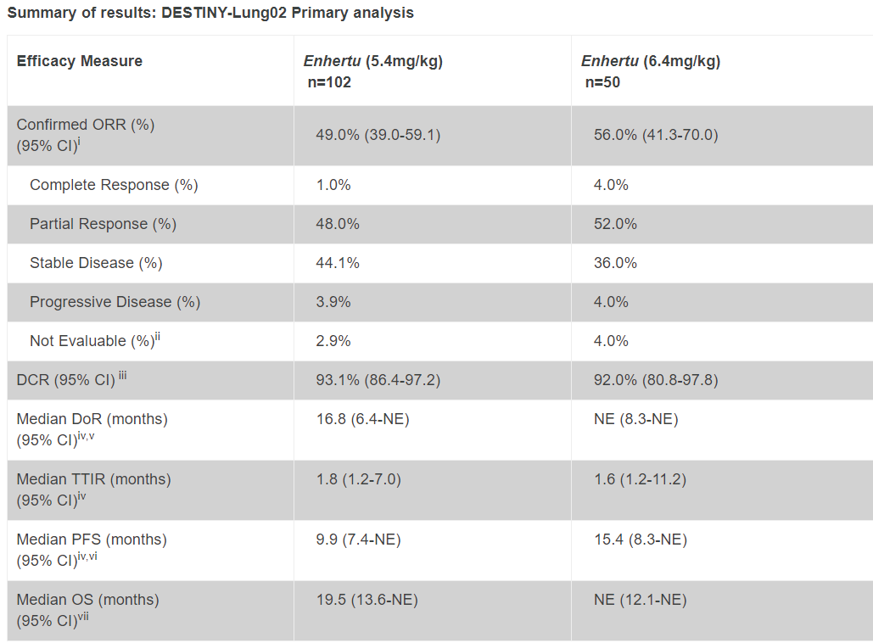
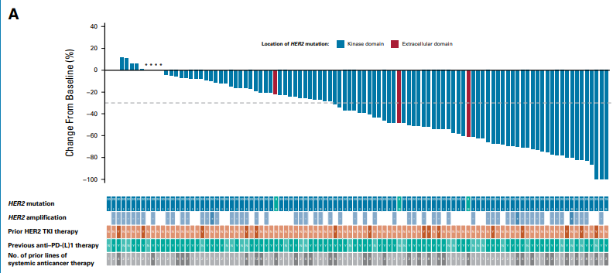
HER-2 IN LUNG CARCINOMAS
93% Her-2 Exon 20 insertions
J Clin Oncol. 2023 Nov 1;41(31):4852-4863.
.

Slide 42
HER-2 IN NSCLC
SUMMARY
There is no good association between Her-2 expression and amplification in NSCLC.
Her-2 overexpression in NSCLC is more associated to Her-2 gene polysomy.
In NSCLC only Her-2 mutations are suitable to anti Her-2 therapy.
Clin. Oncol., 2013, 31, 3997-4013.

Slide 43
HER-2 IN BLADDER CARCINOMAS

Slide 44
HER-2 IN BLADDER CARCINOMAS
DIAGNOSIS – REACTIVE VS IN SITU CARCINOMA
Her-2 expression. In the lower half of the epithelium has high accuracy for differentiating CIS from non-CIS mucosal lesions
Her-2 overexpression in associated with polyssomy of Chr 17 and not with Her-2 gene amplification.
- In normal/ reactive urothelium, Her-2 is expressed in superficial cells.
- Dysplastic urothelium
- Carcinoma in situ
Am J Clin Pathol 2011;136:881-888.

Slide 45
HER-2 IN BLADDER CARCINOMAS
PROGNOSIS – NON MUSCLE INVASIVE BLADDER CARCINOMA (NMIBC)
Higher grade and stage tumors are enriched with Her-2 mutations
Eur Urol. 2017 December ; 72(6): 952–959.

Slide 46
HER-2 IN BLADDER CARCINOMAS
PROGNOSIS – NON MUSCLE INVASIVE BLADDER CARCINOMA (NMIBC)
Her2 amplification distinguishes a subset of non-muscle-invasive bladder cancers with a high risk of progression
-
36 PUNLUMP, 190 LGUC, 178 HGUC.
Herceptest and FISH
IHC and FISH results were in closest agreement when overexpression was defined as 50% of tumour cells showing immunoreactivity.
Her-2 amplification in High grade NMIBC is associated with a aggressive behavior.
J Clin Pathol. 2013 Feb;66(2):113-9.
Notes:
ABSTRACT Background Several studies have employed immunohistochemistry to detect Her2/neu overexpression in urothelial carcinomas, yielding a tremendous range of positive expression rates. Few studies have examined Her2 status in non-muscle invasive bladder cancer (NMIBC) using fluorescence in situ hybridisation (FISH). Aim To evaluate Her2 amplification in NMIBC (Ta/T1), to correlate the findings with recurrence and progression, and compare the Her2 status between primary and progressive tumours. Methods FISH and immunohistochemistry for Her2/neu were performed on tissue arrays consisting of 36 papillary urothelial neoplasms of low malignant potential (PUNLMPs), 190 low grade urothelial carcinomas (LGUCs) and 178 high grade urothelial carcinomas (HG-UCs). 32 cases with specimens of both primary and progressive tumours (from Ta/T1 to T2–4) were included for comparative analyses. Results 16 HG-UCs (9.0%) showed Her2 gene amplification while none of the PUNLMPs and LG-UCs showed this aberration. There was 100% concordance in the status of Her2 amplification between primary and progressive lesions. Immunohistochemistry and FISH results were in closest agreement when overexpression was defined as 50% of tumour cells showing immunoreactivity. The cumulative incidences of recurrence and progression in Her2-amplified HG-UC were significantly higher than in those without amplification. Conclusions A subset of high-grade NMIBCs contain Her2 amplification and are associated with markedly aggressive behaviour. Her2 diagnostics are valuable for distinguishing patients who require diligent surveillance and would potentially benefit from anti-Her2 therapies.

Slide 47
HER-2 IN BLADDER CARCINOMAS
PROGNOSIS – NON MUSCLE INVASIVE BLADDER CARCINOMA (NMIBC)
Human epidermal growth factor receptor 2 expression is more important than Bacillus Calmette Guerin treatment in predicting the outcome of T1G3 bladder cancer
-
67 TURBT T1G3 NMIBC : 33 ALONE AND 34 WITH BCG
IHC (VENTANA) according to breast guideline.
2+ and 3+ were considered positive (44%)
Oncotarget. 2017 Apr 11;8(15):25433-25441.
Notes:
In the present study we tested the role of Human Epidermal Growth Factor Receptor-2 (HER-2) expression, as assayed by immunohistochemistry, in predicting recurrence and progression in 67 patients with T1G3 BC having undergone transurethral resection of bladder tumor (TURBT) alone (33) or TURBT + Bacillus Calmette Guerin (BCG) instillations (34). All patients had a negative restaging TURBT within 4 months after the first TURBT. At median follow-up of 75.7 months, the overall disease-free and progression-free rates were 35.8% and 73.0%, respectively. Univariate Kaplan-Meier survival analysis showed that traditional prognostic factors (sex, tumor number/size/recurrence) failed to predict disease-free and progression free survival (DFS, PFS). BCG treatment was a significant predictor of DFS (p=0.0231) but not of PFS (p=0.6901). HER-2 overexpression was a significant predictor of DFS (p=0.0013) and PFS (p=0.0322) in the overall patients population, but failed to predict PFS when patients were stratified for treatment (BCG: p=0.1290; no BCG: p=0.1696) probably due to the limited number of events. Multivariate Cox proportional-hazards regression analysis confirmed that BCG treatment was a significant predictor of DFS (p=0.012) but not of PFS (p=0.924), whereas HER-2 overexpression was a significant predictor of DFS (p=0.001) and PFS (p=0.041). These findings suggest that HER-2 status performs better than "traditional" prognostic factors as well as of BCG treatment in predicting the outcome of T1G3 BC, thus providing grounds for further testing this marker and possibly incorporating it in a panel of molecular markers that could reliably predict the behavior of this challenging disease.

Slide 48
HER-2 IN BLADDER CARCINOMAS
Human Epidermal Growth Factor Receptor 2 Overexpression in Micropapillary and Other Variants of Urothelial Carcinoma
-
Histology | % Her-2 positivity
Micropapillary | 56% (34/60)
Conventional invasive UC | 36% (9/25)
In Situ Urothelial Carcinoma | 50% (4/8)
Lipid Cell Variant | 50% (3/6)
Glandular UC | 0% (0/8)
Small Cell UC | 0% (0/6)
Sarcomatoid UC | 0% (0/5)
Low Grade Non Invasive | 0% (0/20)
High Grade Non Invasive | 20% (2/10)
25 invasive, 20 low-grade noninvasive,
and 10 high-grade noninvasive UC cases;
8 in situ UC cases; and 69 UC variant.
CAP/ASCO breast guideline
3+ considered positive
Eur Urol Focus. 2018 Apr;4(3):399-404.

Slide 49
Median PFS: 7 months
PFS 6m: 57,6 %
PFS 12 m: 22,8 %
Median OS: 12,8 months
PFS 6m: 77,6 %
PFS 12 m: 62,6 %
Meric-Bernstam F, et al. J Clin Oncol. 2024 Jan 1;42(1):47-58

Slide 50
HER-2 IN BLADDER CARCINOMAS
SUMMARY
There is a low agrrement between ihc and ish in bladder carcinomas.
Better aggreement is reached with >50% of positive cells by ihc.
Her-2 expression is associated with poor dfs and pfs in bc.
Her-2 is highly expressed in ucis, micropapillary bc and conventional uc.
Glandular, sarcomatoid and small cell uc are mostly her-2 negative.
Urothelial bladder carcinomas with Her-2 3+ expression have the best clinical benefits with anti Her-2 therapy (T-Dx)
-
Eur Urol Focus. 2018 Apr;4(3):399-404.

Slide 53
HER-2 AGNOSTIC TRAZTUZUMAB DERUXTECAN
Based on these 3 studies Her-2 T-DXd was approved of agnostic therapy for advandced tumors that produces high levels of Her-2 protein her-2 3+) that were submitted at least by 1 previous therapy.
Exceptions for indication.
. NSCLC that the indication is Her-2 mutation.
. CRC: Her-2 3+.
- The samples should be analyzed using ASCO/CAP GI.
Meric-Bernstam F, et al. J Clin Oncol. 2024 Jan 1;42(1):47-58; Nat Commun 14, 3332 (2023); J Clin Oncol. 2023 Nov 1;41(31):4852-4863

Slide 54
Thank You!
CRISTOVAM SCAPULATEMPO NETO
11-992422218
cristovam.neto@altadiagnosticos.com.br

